Slide 1
Critical points and TAG

Slide 2
Method
Extracted min and max pixels from the 2D image using matlab.
Extracted watershed (ws) and watercourse (wc) pixels using matlab functions.
Extracted saddles as intersections of watershed and watercourse pixels. (we considered an intersection as those where 1) a pixel is both a watershed and watercourse pixel; 2) where ws and wc pixel are immediate neighbors).
We solved the heat equation by fixing 1) min and max point intensities; 2) min, max, ws, wc point intensities (actual fixing ws and wc pixels automatically fixes min and max points as well since ws and wc lines pass through min and maxs); 3) min, max, saddle point intensities.
We also measured compression ratios.

Slide 3
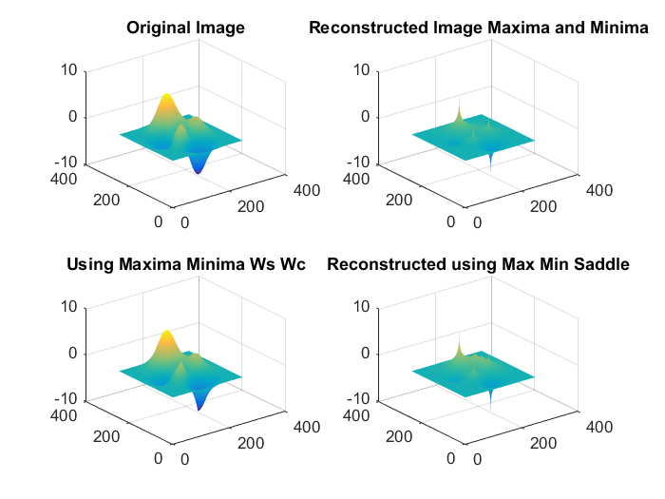
Gaussians

Slide 4
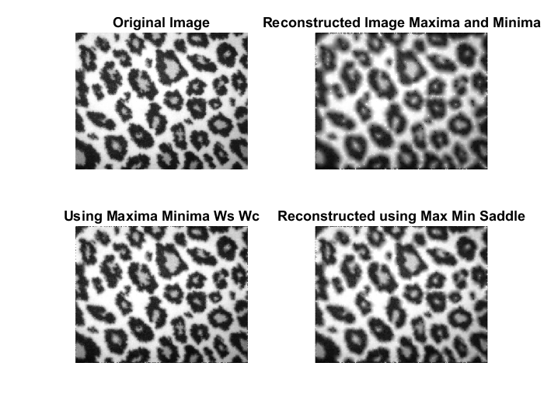
Cheetah pattern

Slide 5
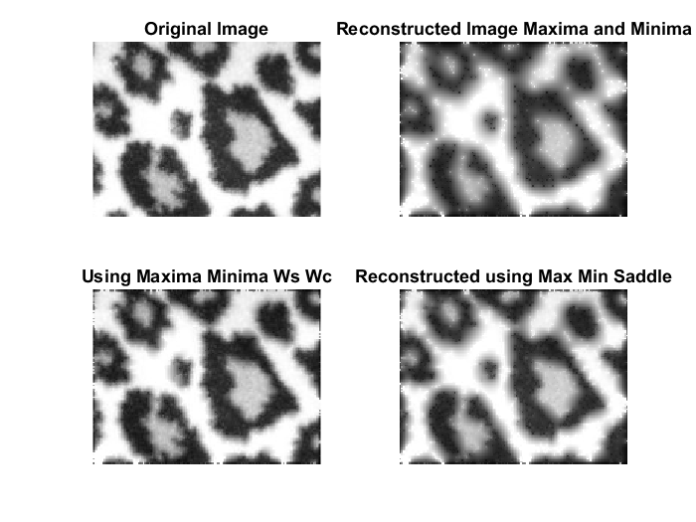
Portion of cheetah pattern

Slide 6
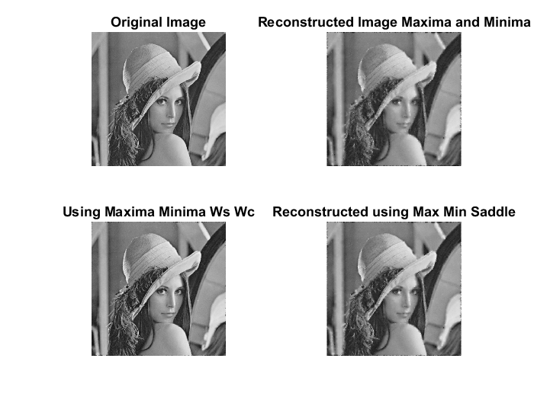
Lena image

Slide 7
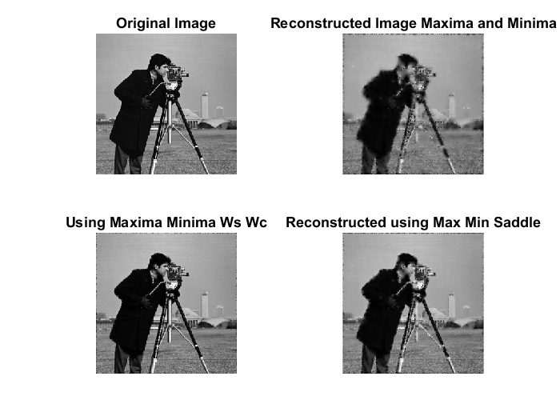
Cameraman

Slide 8
Observations
We see fixing the min, max, ws, wc pixels gives good reconstructions.
Fixing just the mins and max does recover quit a bit of the image. The saddles make it better.
The compression ratio with just fixing the mins and max points was around 6% for the cameraman. We can get you the compression ratios for others.

Slide 9
A closer look at the mins, maxs, watershed and watercourse lines, edges
We looked closely at min, max, ws and wc, edges
We reconstructed the image by solving the heat equation by fixing the edges points as well (sobel edge detector) to see how smoothing across edges can be avoided.
E.g. images: cheetah, Lena, Gaussians, and smaller patches of them.

Slide 10
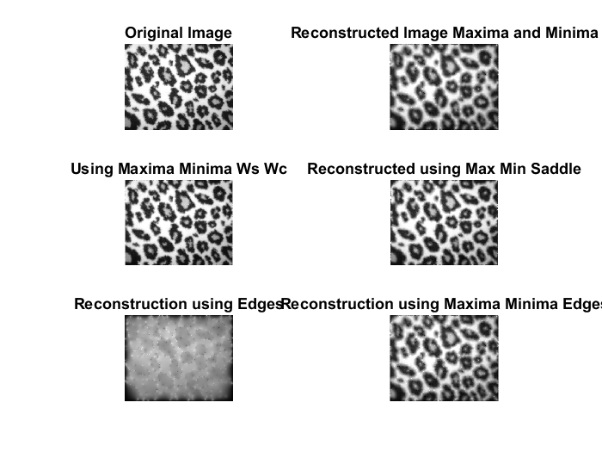
Cheetah reconstruction

Slide 11
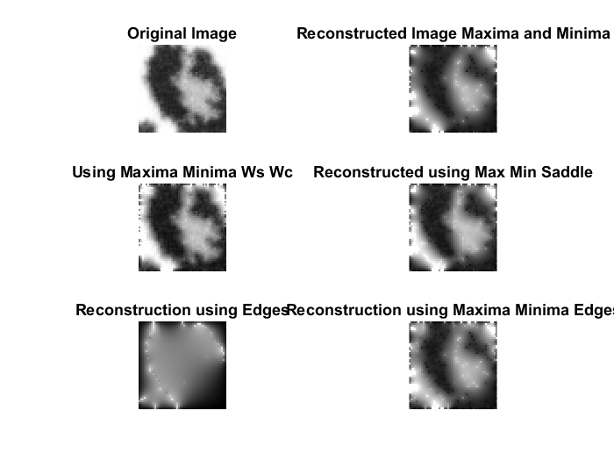
A specific patch in Cheetah

Slide 12
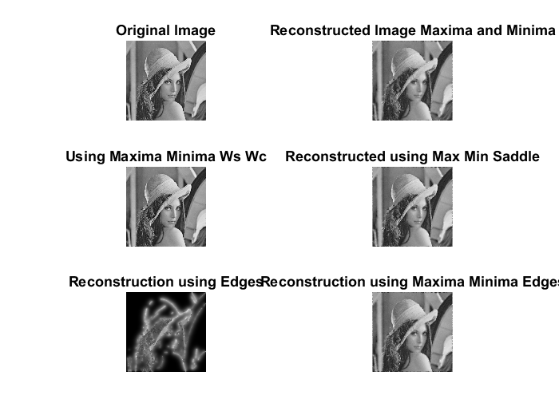
Lena reconstruction

Slide 13
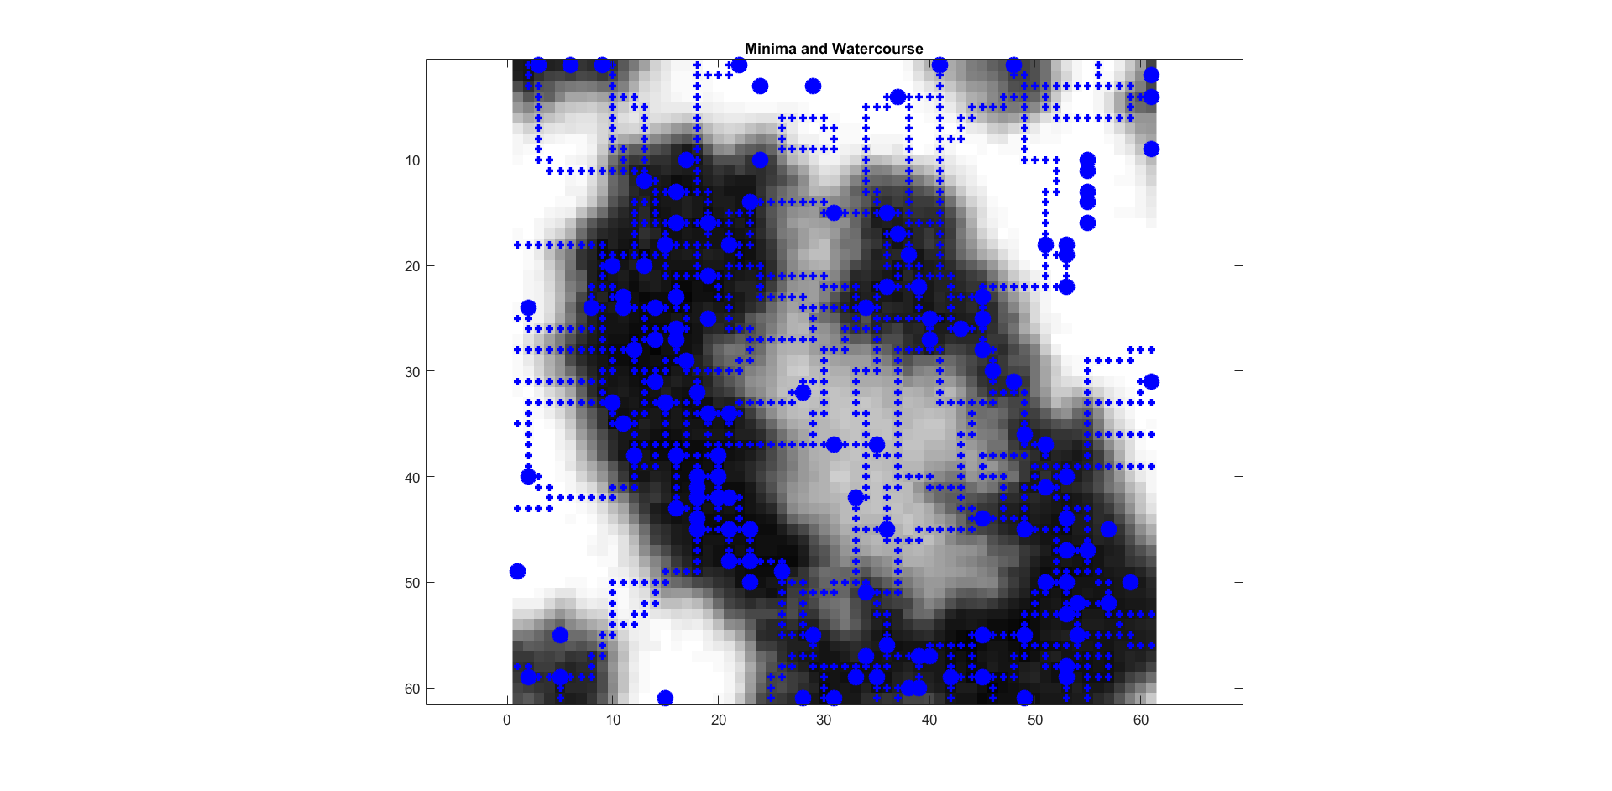
Cheetah patch: closer look at min (blue dots), wc (blue plusses)

Slide 14
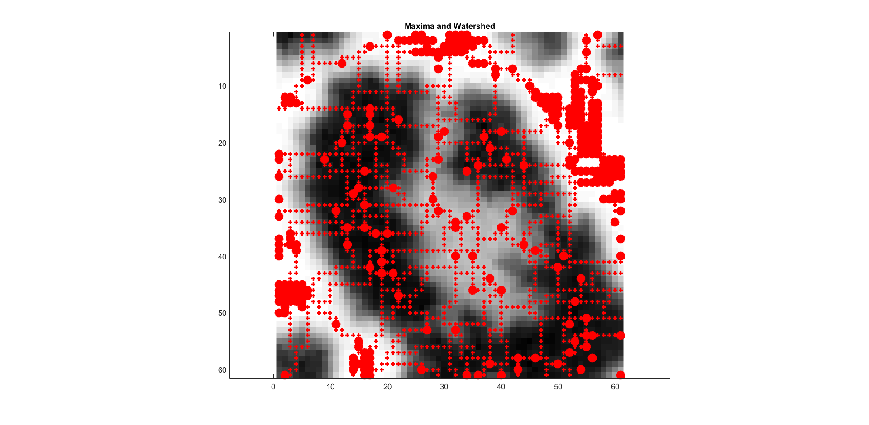
Cheetah patch: closer look at max (red dots), ws (red plusses)

Slide 15
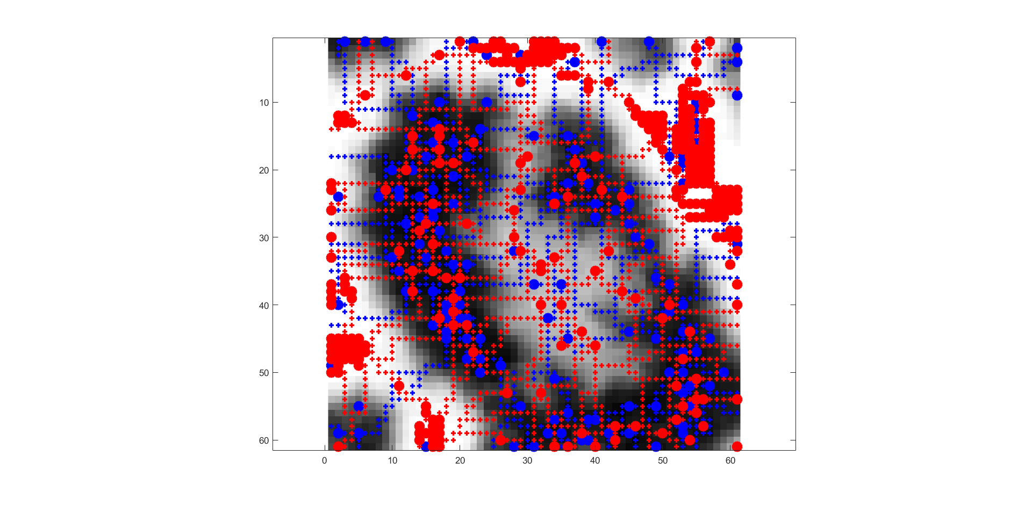
Cheetah patch: Closer look at min, max, ws, wc

Slide 16
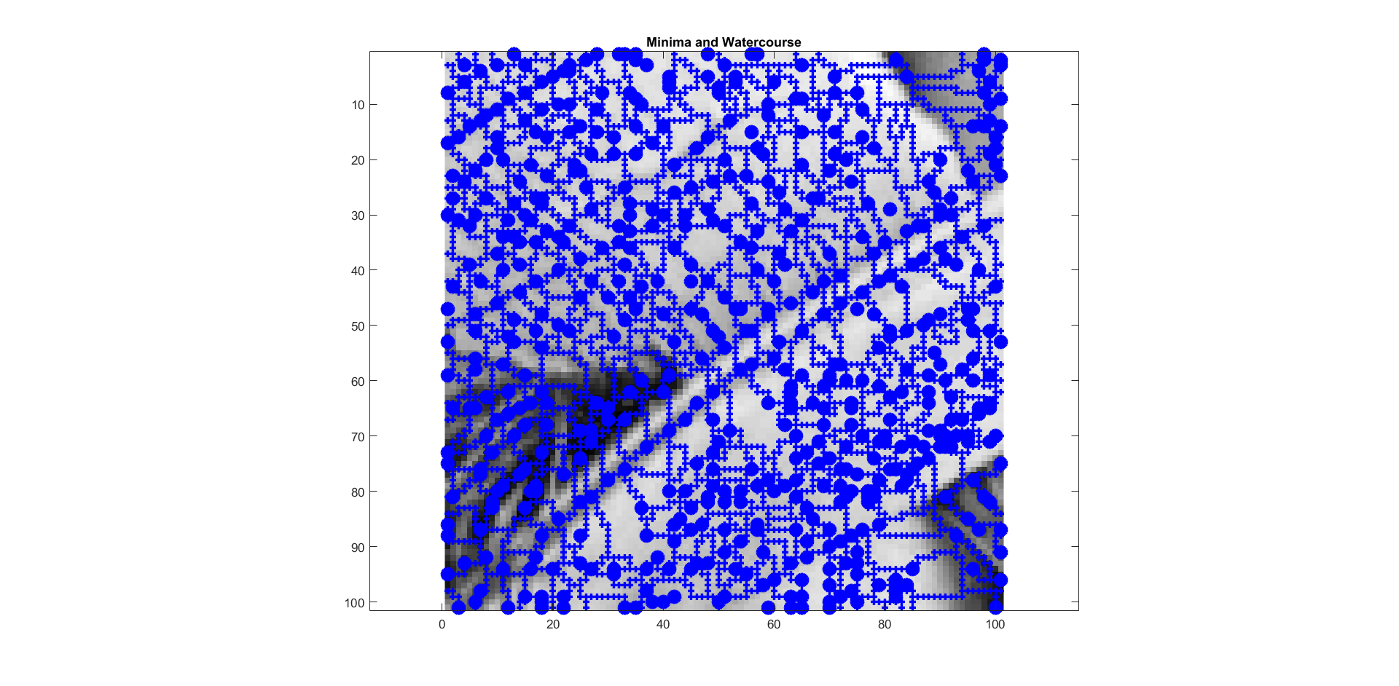
Lena patch: closer look at mins(blue dots), wc (blue plusses)

Slide 17
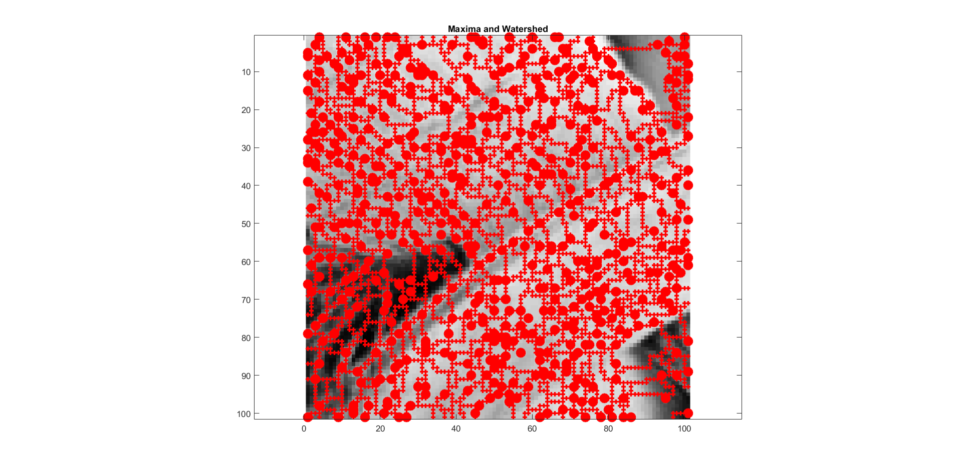
Lena patch: closer look at maxs (red dots), ws (red plusses)

Slide 18
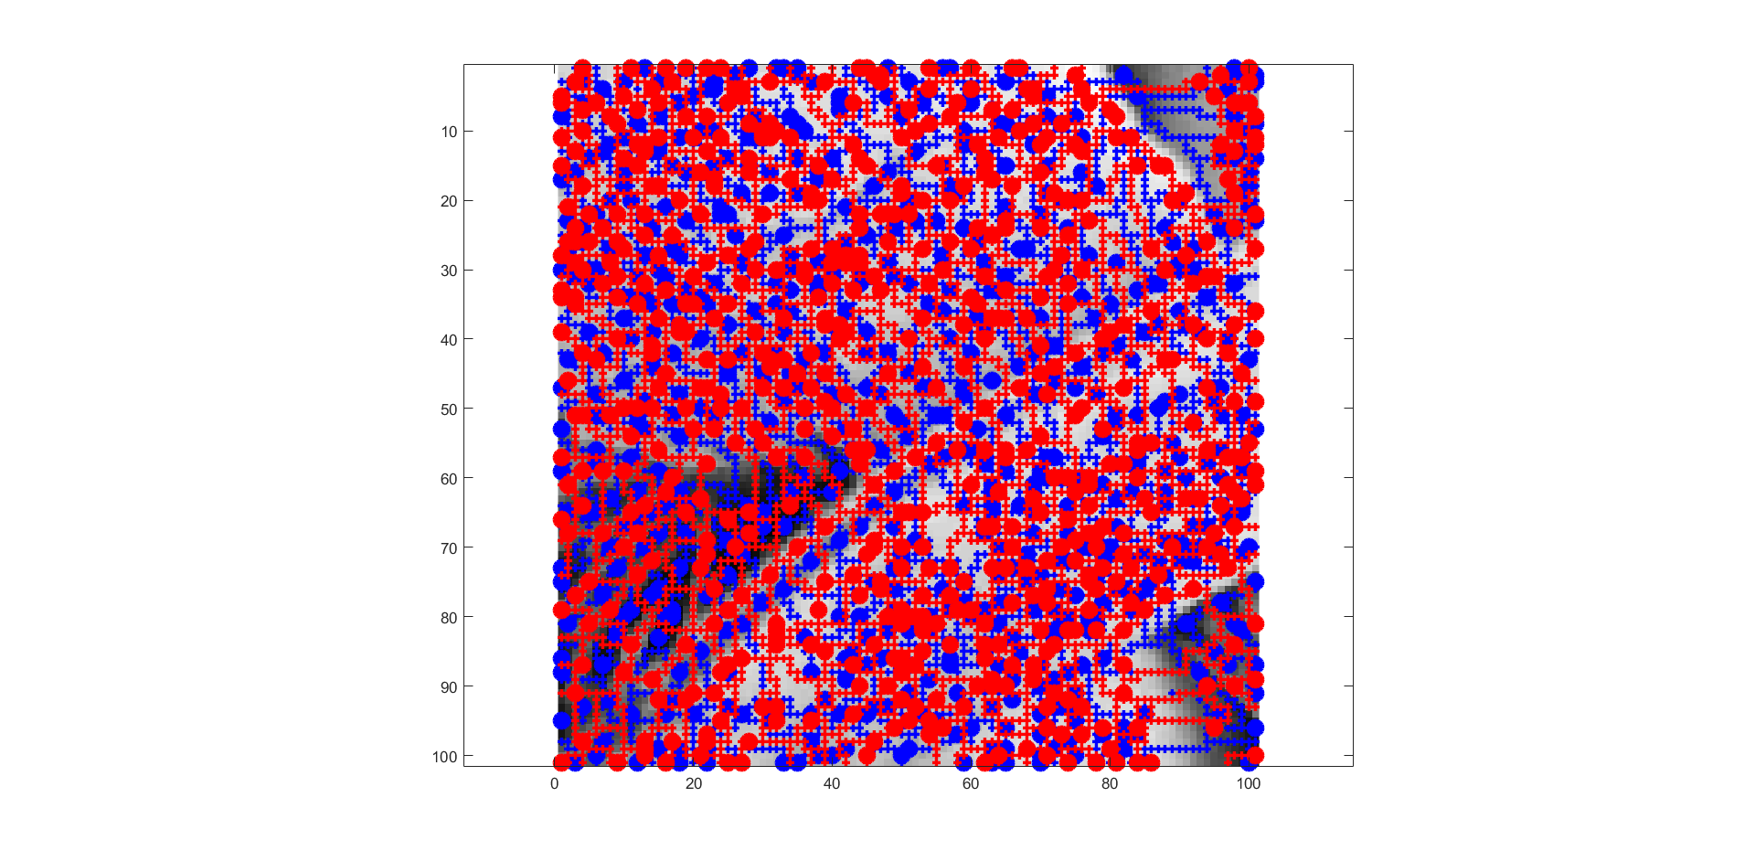
Lena patch: closer look at mins, max, ws, wc (this is crowded, we will update it with a smaller patch)

Slide 19
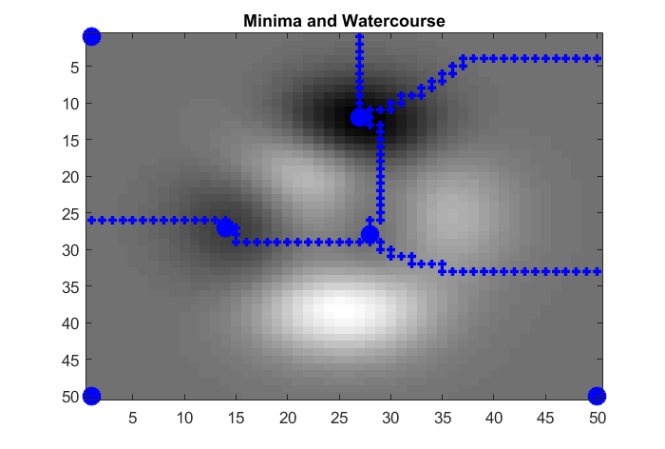
Gaussians: closer look at min (blue dots), wc (blue plusses)

Slide 20
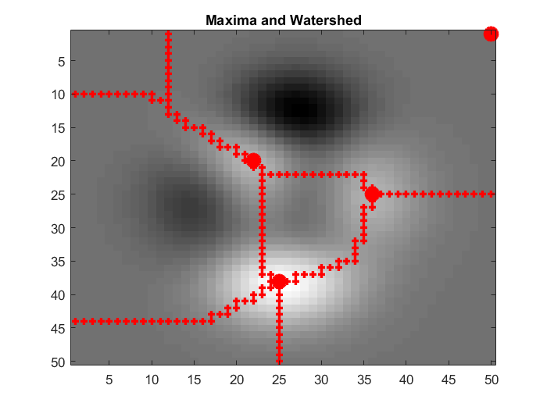
Gaussians: closer look at max (red dots), ws (red plusses)

Slide 21
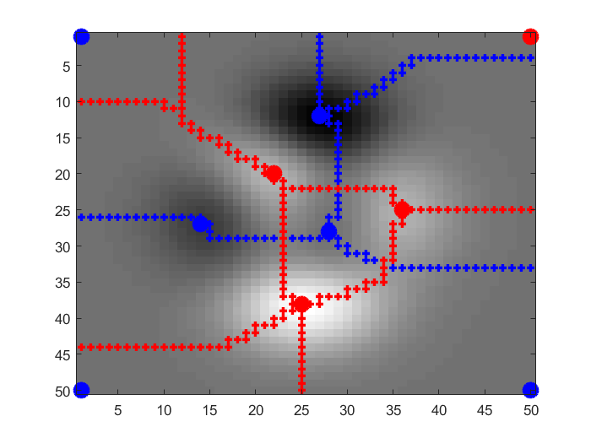
Gaussians: min, max, ws, wc

Slide 22
Observations
Fixing the edges and min and max points is not necessarily giving better reconstruction than fixing min, max and saddles. But it seems like we have fewer edge points than saddles, hence higher compression.
There are certain places where the wc, ws course line take sharp turns. These need to be investigated more.

Slide 23
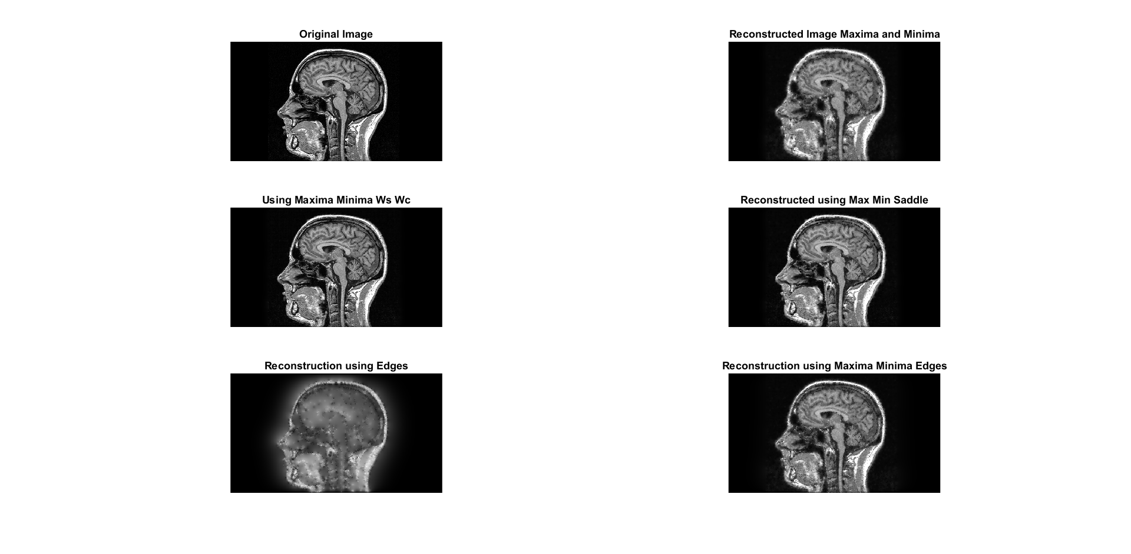
Reconstruction on medical images

Slide 24
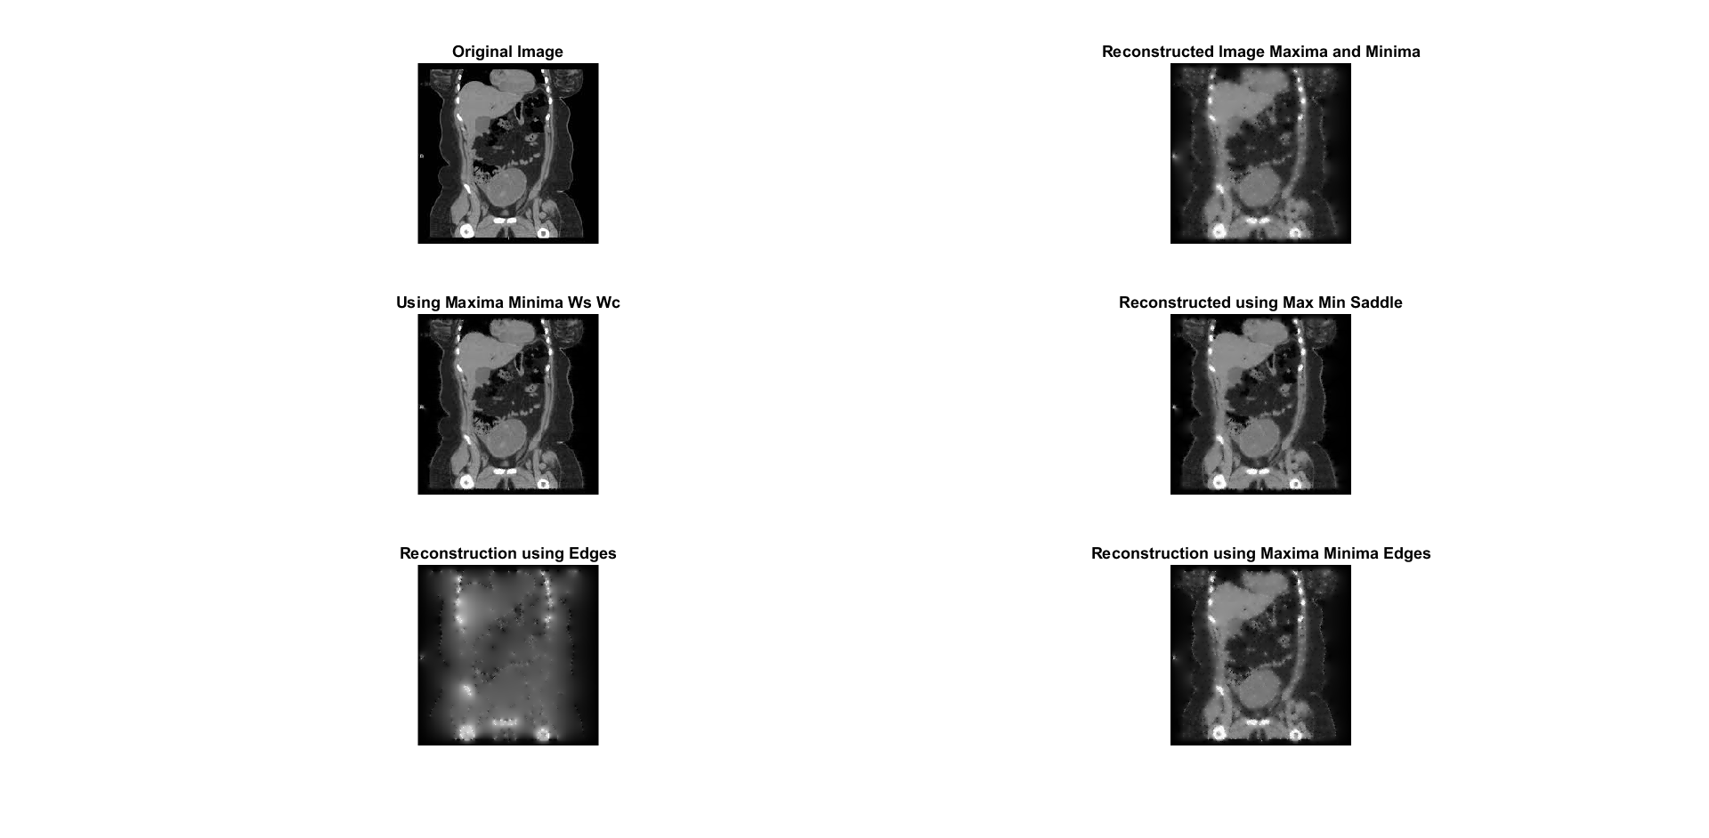

Slide 25
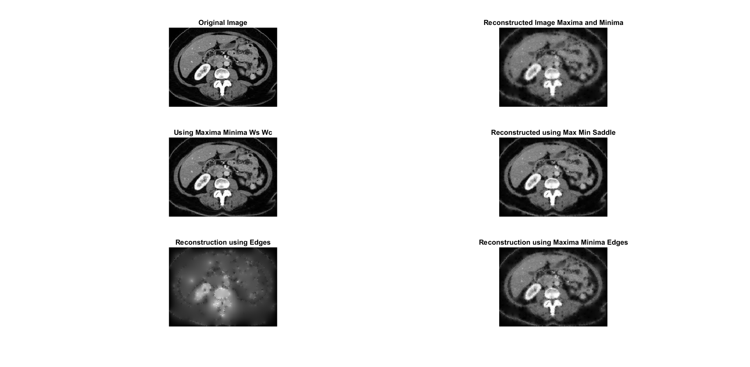

Slide 26
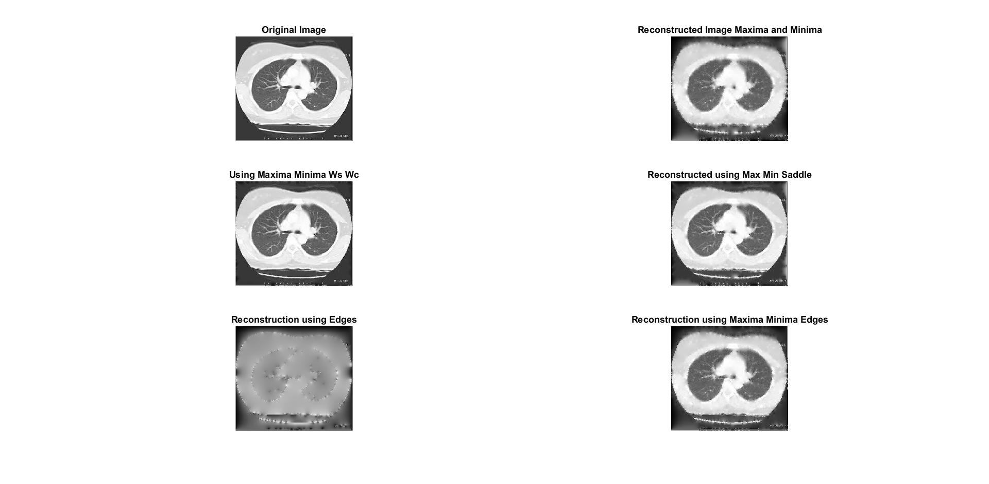

Slide 27
Image matching experiments using critical points
We used robot data set: We downloaded 6 scenes (houses, books, burger etc.) Each scene has ~2300 images taken from different viewpoints and changes in illumination etc.
Experiment: We picked a few images as query from each scene and matched it to images from all scenes to get the closest image.
Features: 1) SIFT key points and SIFT descriptor; 2) Mins as key points and SIFT descriptor; 3) Maxs as key points and SIFT descriptor.
Matching criterion between two images: Compute number of corresponding features in the two images (the feature correspondence was done using Lowe’s method. We used his code). Find the image that gives the highest number of corresponding features.
Observation: From a basic run, we see that the maxs and mins can retrieve a close match. But it is very slow since the number of maxs and mins are very high. We will be smoothing the image and then computing the mins and maxs, which will reduce their number and run image matching again.

Slide 28
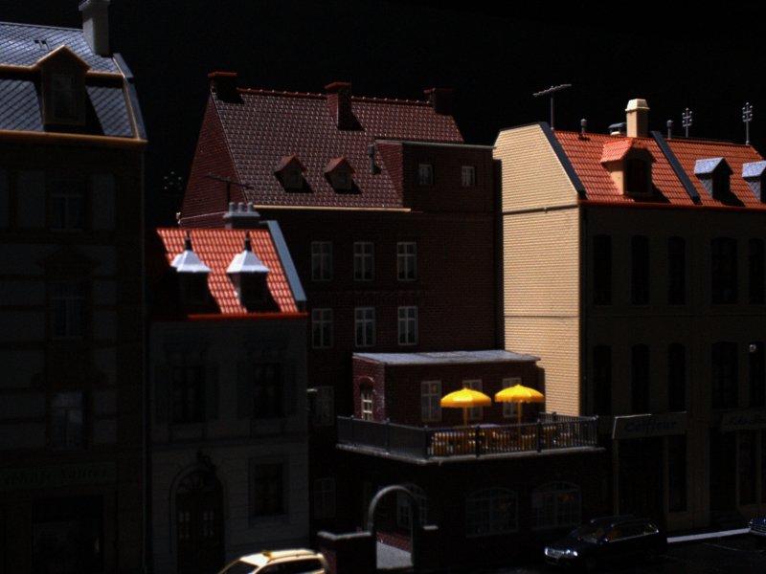
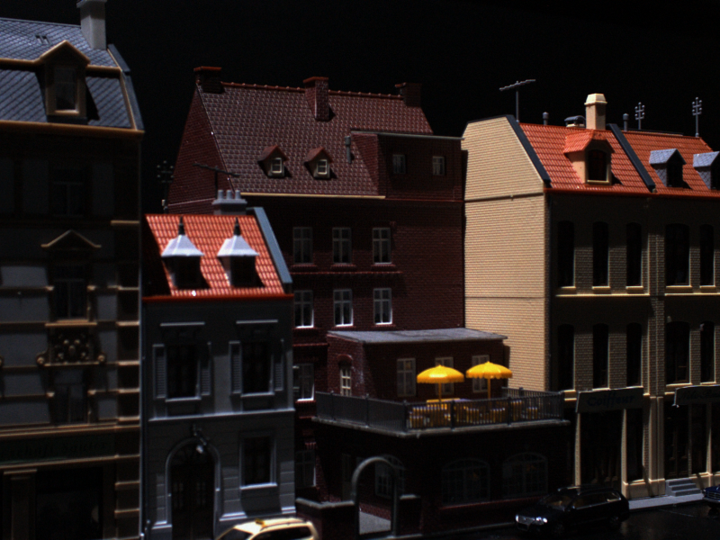
SIFT matches
The query was removed from the data base while matching.
Query Image
Matched Image

Slide 29
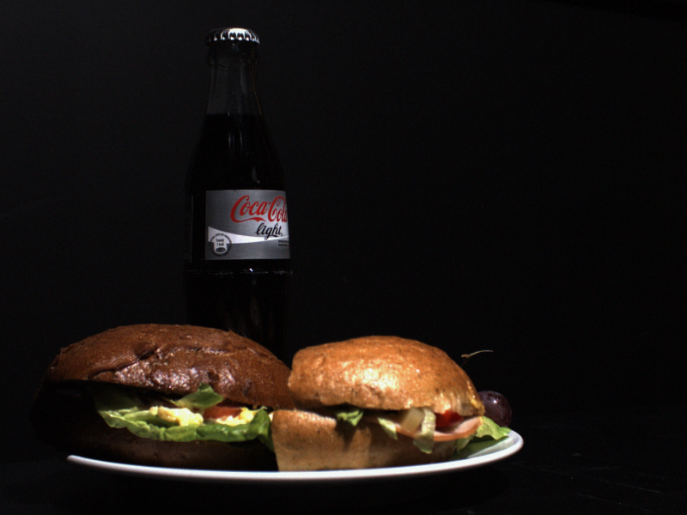
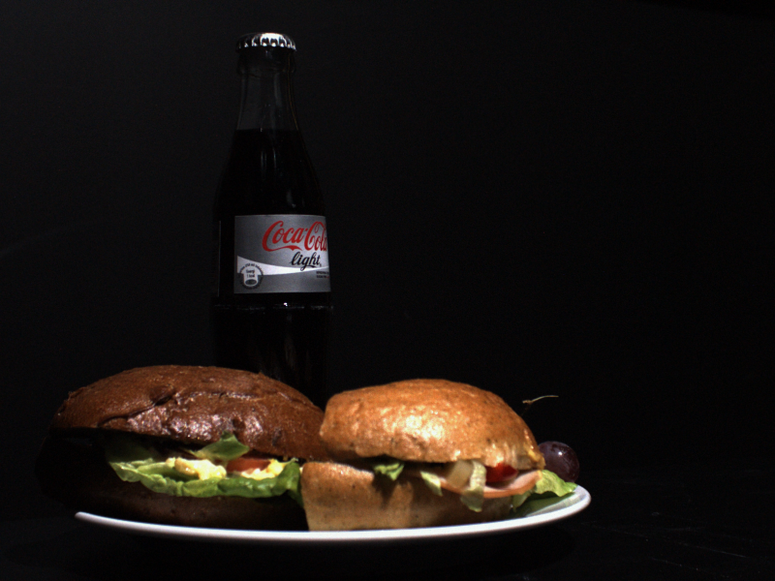
Match using Mins
The query was removed from the data base while matching. But there was a very close image.
Query Image
Matched Image

Slide 30
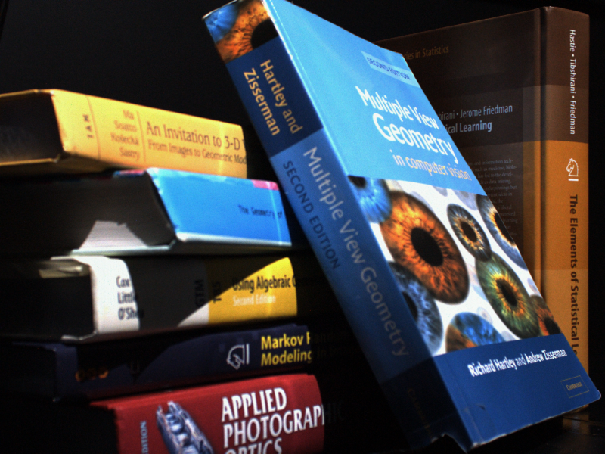
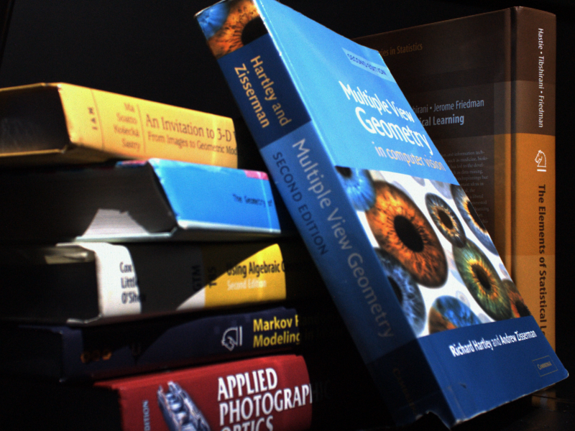
Match using Maxs
The query was removed from the data base while matching. But there was a very close image.
Query Image
Matched Image

Slide 31
Critical points with scale and image matching, compression ratios
# critical points with scale: Gaussian smoothing, and generated graphs for varying sigma.
Image matching using the smoothed images, with reduced critical points
Compression ratio of image reconstruction using 1) critical points; 2) critical points + ws/wc
Observation on the reconstruction with critical points, ws,wc.

Slide 32
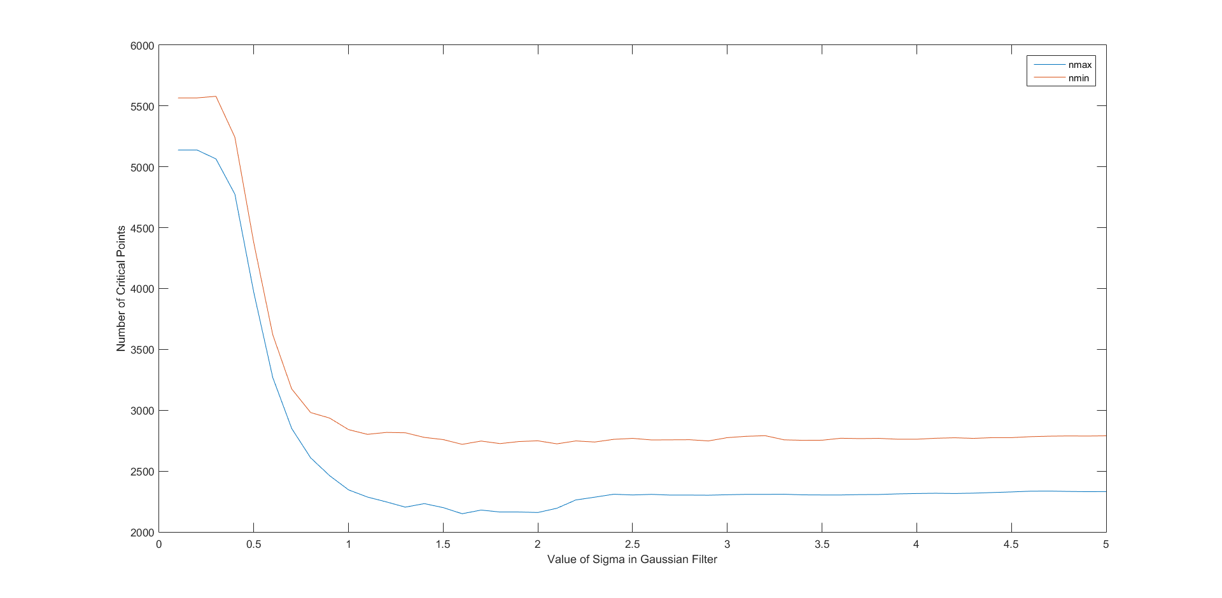
# critical points with scale
Camera man image

Slide 33
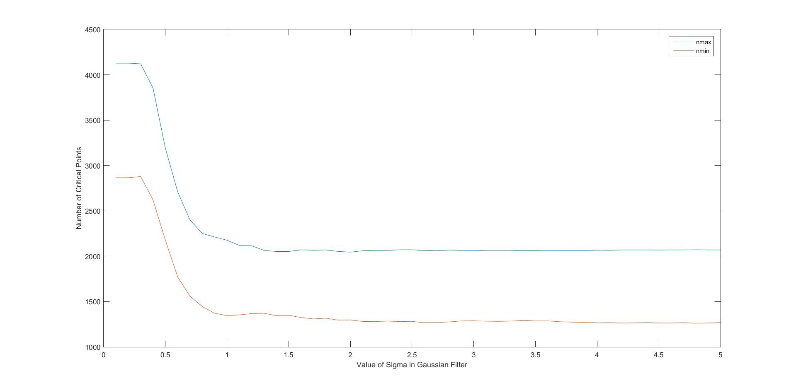
# critical points with scale
Cheetah pattern image

Slide 34
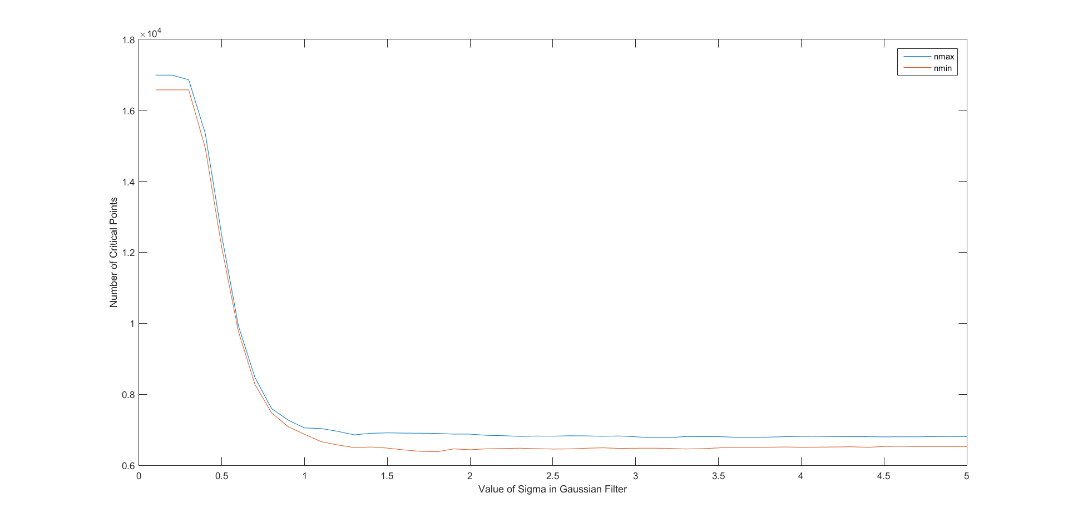
# critical points with scale
Lena image

Slide 35
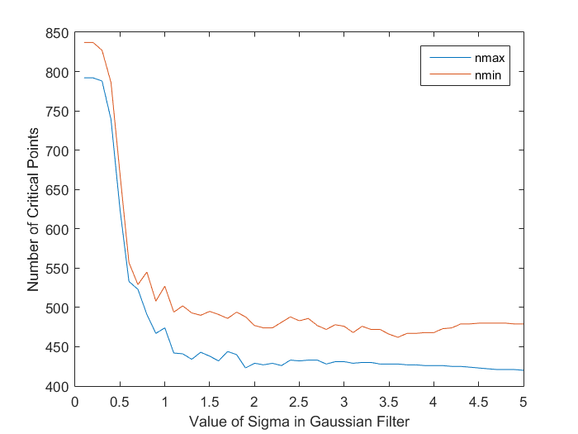
# critical points with scale
Onion image

Slide 36
Observation
We see that for all 4 images, the number of critical points drops quickly at a certain scale.
If we scale the images for e.g. Lena by sigma = 2, the number of mins and maxs by decreases by around half, as can be seen in the graphs.

Slide 37
Image matching experiments using smoothed images
Data set: For the image matching experiments, we used robot data set. Picked 6 queries and 300 database images to which we want to match the queries. (the query is not part of the database). All images were scaled using a Gaussian sigma = 5.
Matching method: We used mins instead of SIFT key points, used SIFT descriptor and used Lowe’s method to find feature correspondences. The image that gives the highest number of corresponding features is the matching image.
Result: We report below, the query as well as the non smoothed version of the retrieved image

Slide 38
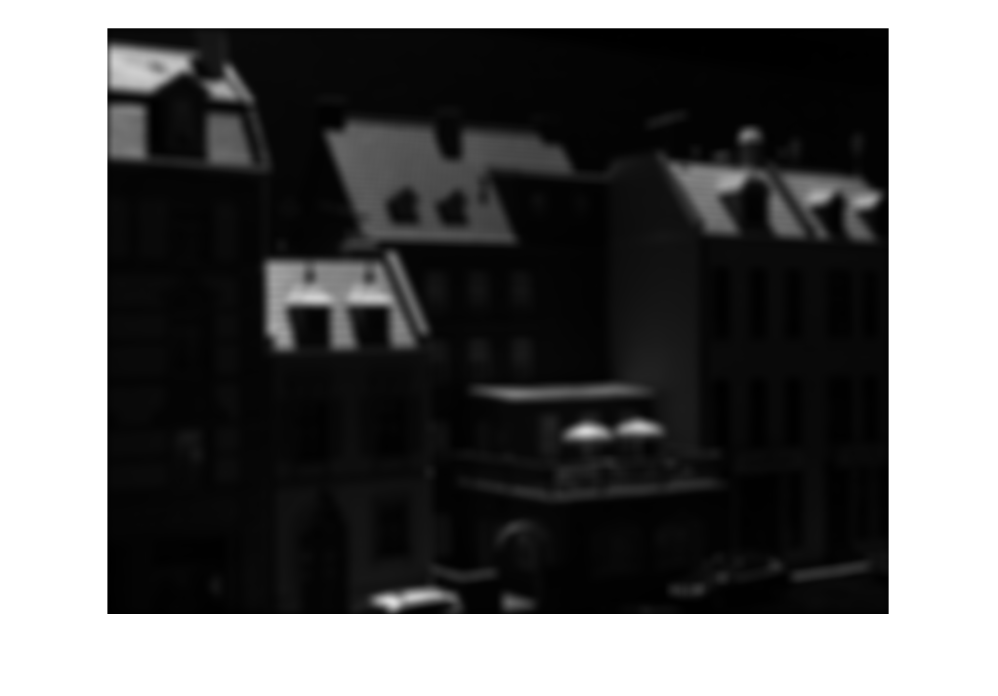
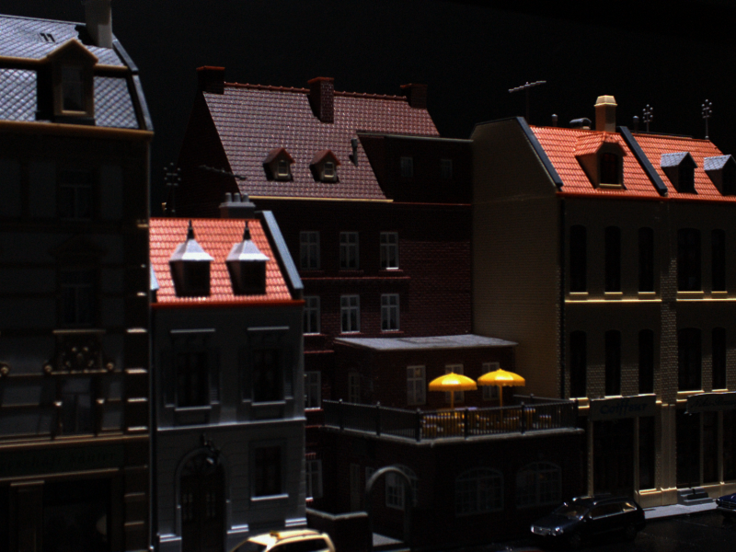
Image matching based on mins using the smoothed image (about 1/6 reduction in # maxs)
Query
Retrieved

Slide 39
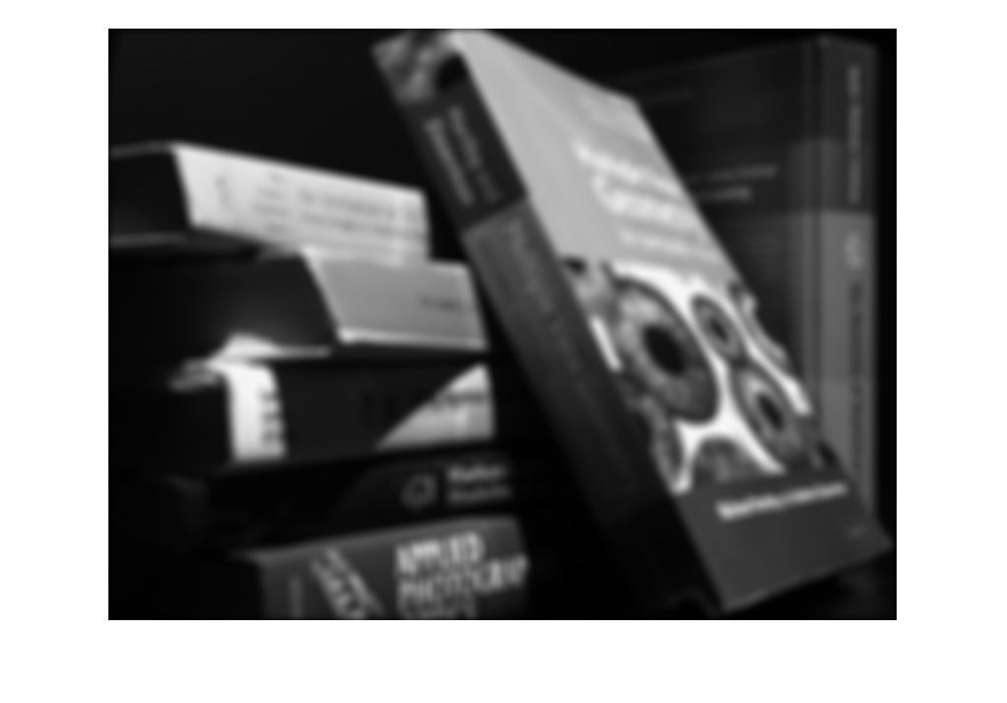
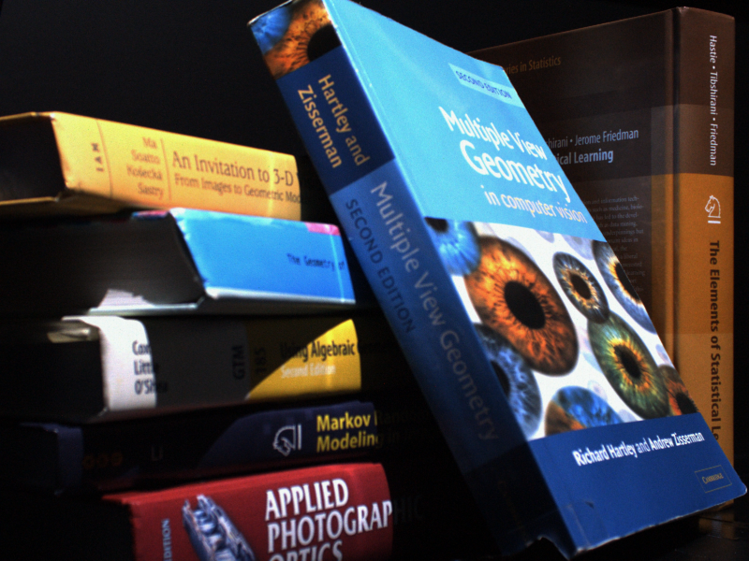
Image matching based on mins using the smoothed image (about 1/6 reduction in # maxs)
Query
Retrieved

Slide 40
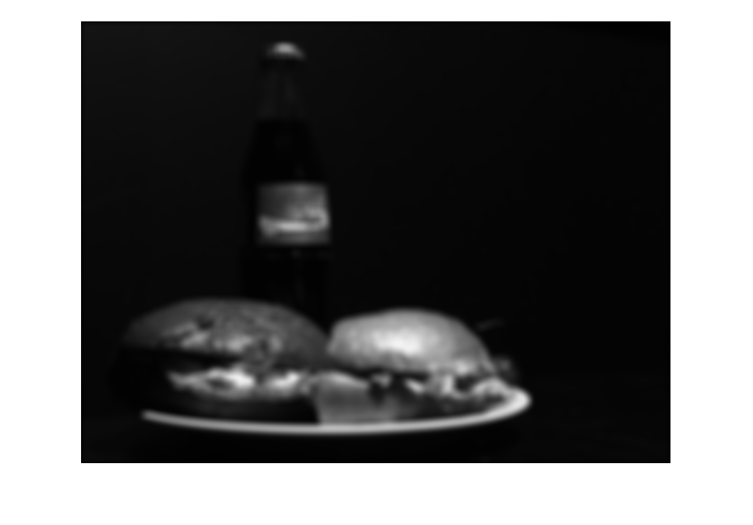
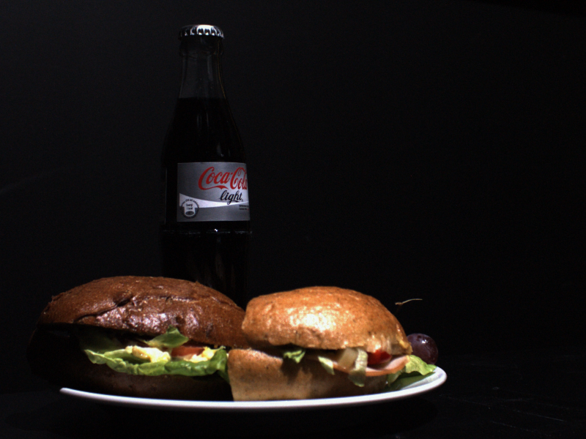
Image matching based on mins using the smoothed image (about 1/6 reduction in # maxs)
Query
Retrieved

Slide 41
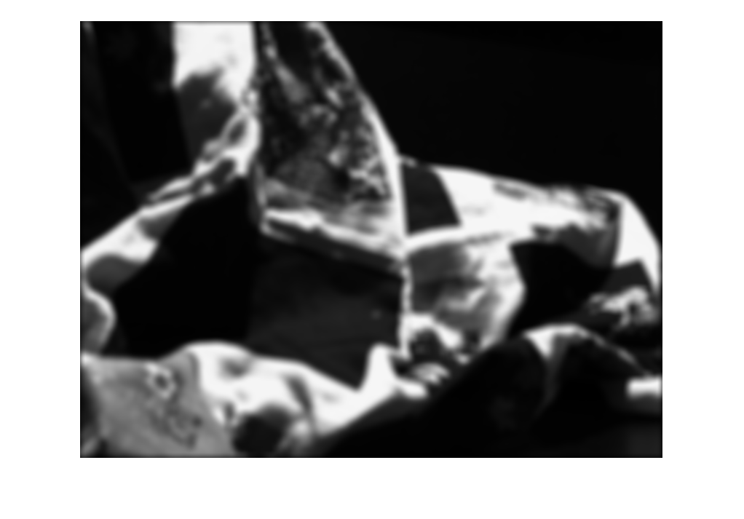
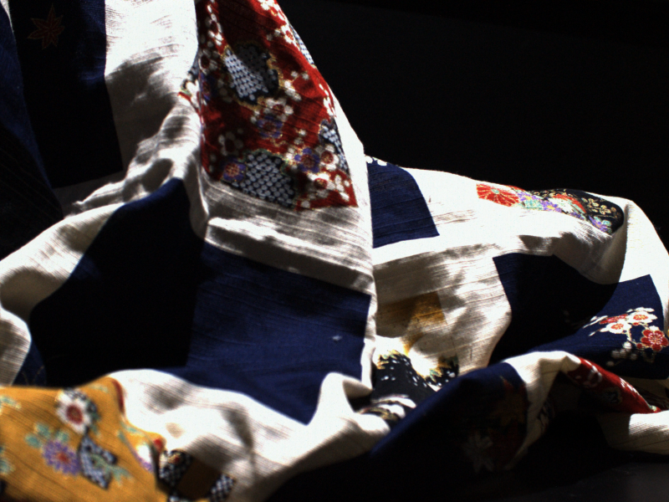
Image matching based on mins using the smoothed image (about 1/6 reduction in # maxs)
Query
Retrieved

Slide 42
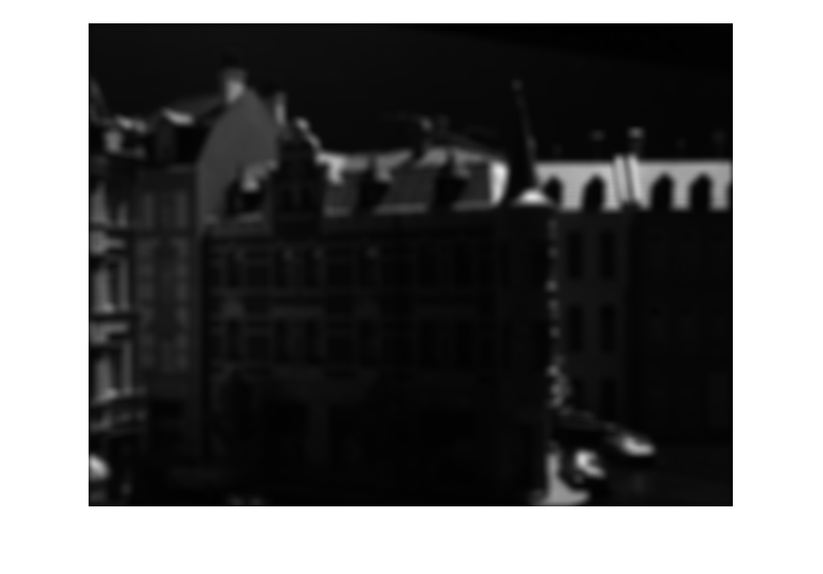
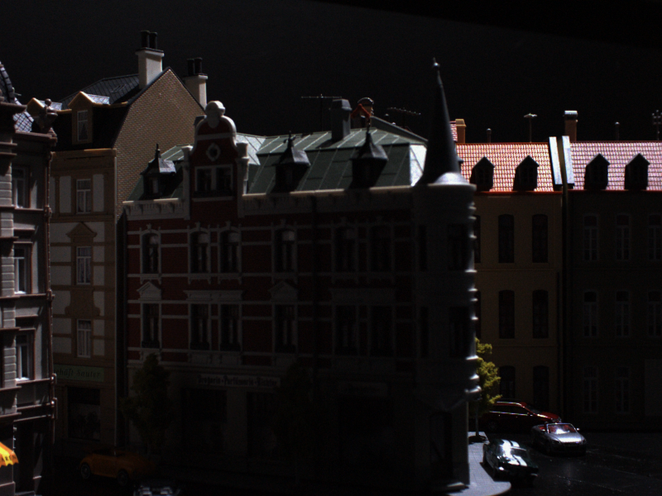
Image matching based on mins using the smoothed image (about 1/6 reduction in # maxs)
Query
Retrieved

Slide 43
Observation
We see that even when the images are smoothed, the mins are able to retrieve a very similar image. The number has decreased by 1/6th.
We only tested query against 300 images. But next we are testing query against 300 images.

Slide 44
Image Matching Results
We have used the Robot Point Feature Dataset for the image matching experiments
The images are of Scenes 1-6, and have a resolution of 600x800.
Each scene has images of the same object taken from 119 different poses and further, each pose has 19 different levels of illumination.
There are two cases
Query smoothed using Gaussian filter, Database image not filtered
Both Query and Database smoothed with Gaussian Filtered

Slide 45
SIFT Matching - I
Query filtered using Gaussian filter of size 12x12, sigma=2, Database image not filtered
Database Images – 300 (50 from each of 6 scenes)
Query Images – 18 ( 3 from each scene)
Time Taken to Run – 3 hours
Success Rate (Counting image from same scene as positive match) – 100%
Success Rate (Counting image from same pose and differing in illumination level by +/- 3) – 28.5%

Slide 46
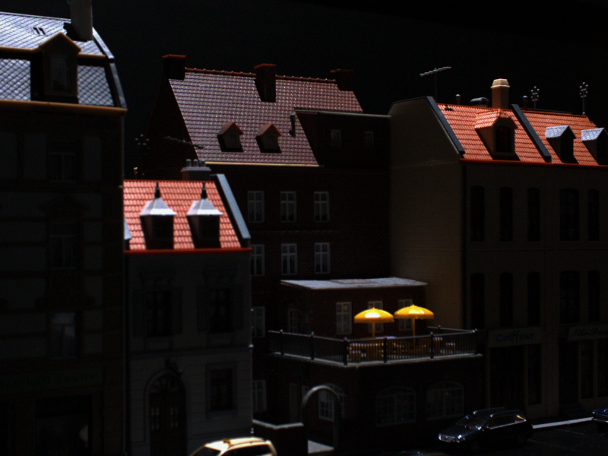
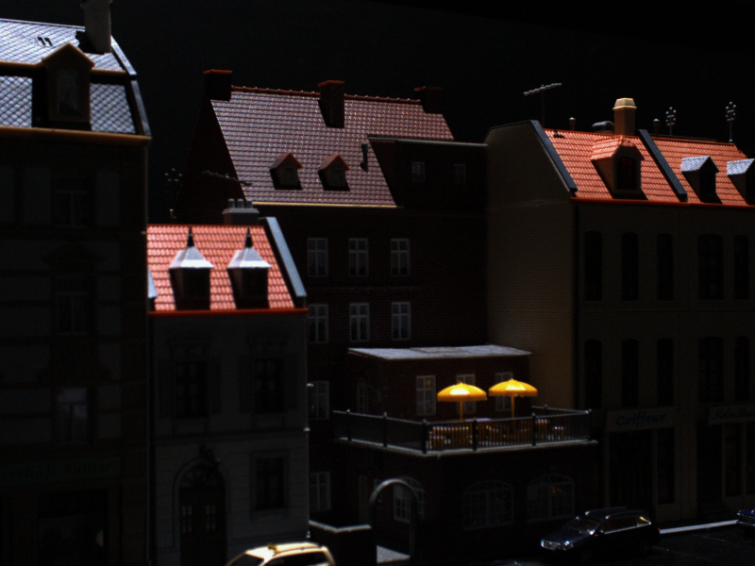
Result
Query
Retrieved

Slide 47
SIFT Matching - II
Query and Database image smoothed using Gaussian filter of size 15x15, sigma=2
Database Images – 300 (50 from each of 6 scenes)
Query Images – 18 ( 3 from each scene)
Time Taken to Run – 3 hours
Success Rate (Counting image from same scene as positive match) – 100%
Success Rate (Counting image from same pose and differing in illumination level by +/- 3) – 44.44%

Slide 48
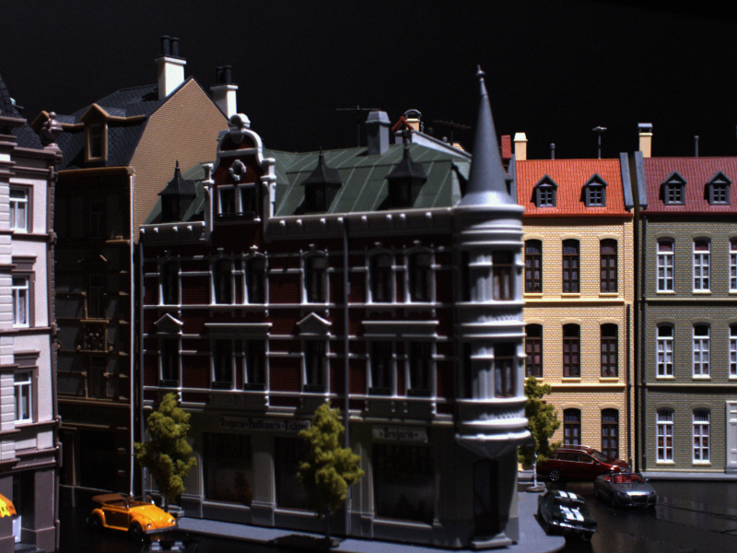
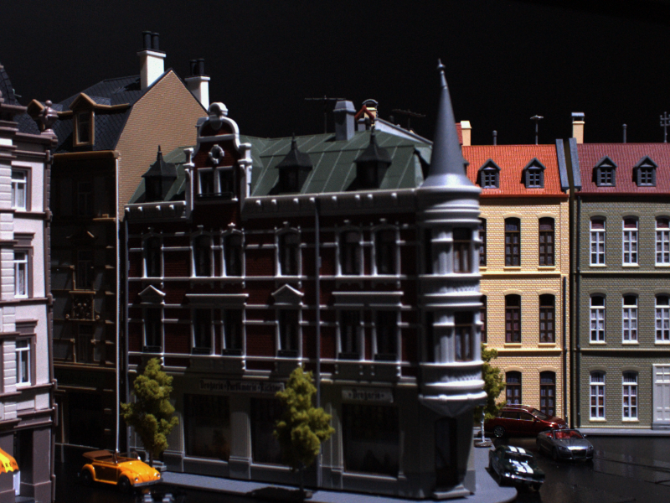
Result
Query
Retrieved

Slide 49
Maxima Matching - I
Query and Database image smoothed using Gaussian filter of size 15x15, sigma=5
Database Images – 300 (50 from each of 6 scenes)
Query Images – 18 ( 3 from each scene)
Time Taken to Run – 4 hours
Success Rate (Counting image from same scene as positive match) – 100%
Success Rate (Counting image from same pose and differing in illumination level by +/- 3) – 83.3%

Slide 50
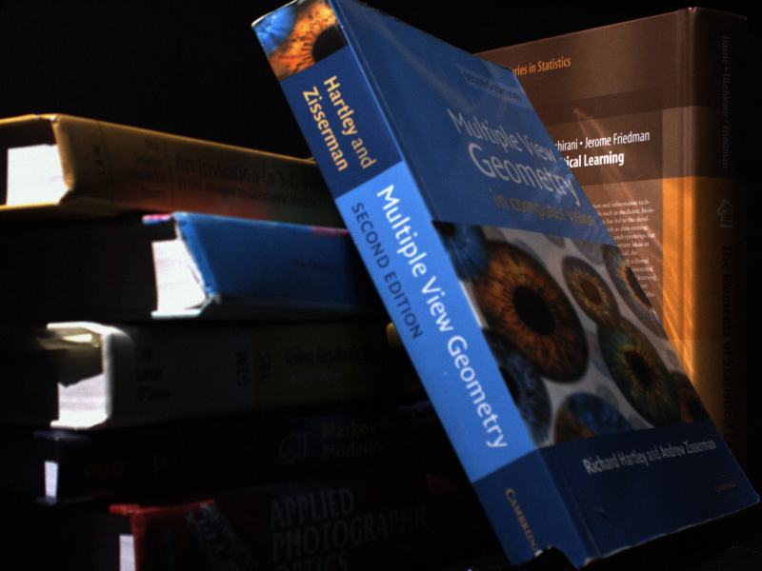
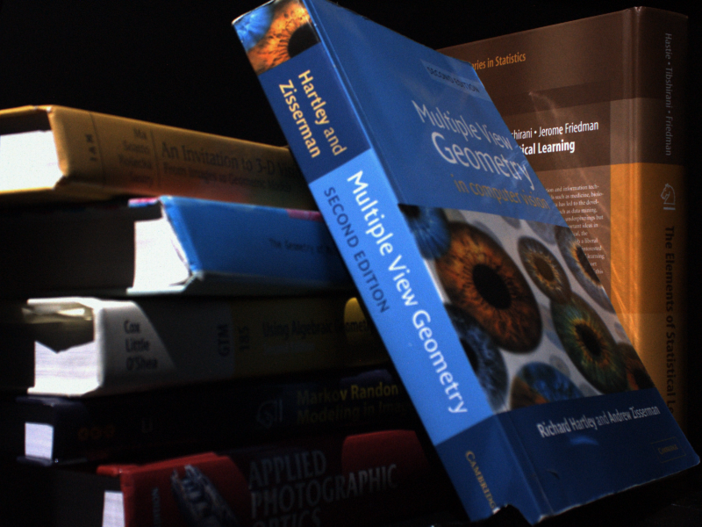
Result
Query
Retrieved

Slide 51
Minima Matching - I
Query filtered using Gaussian filter of size 12x12, sigma=2, Database image not filtered
Database Images – 300 (50 from each scene)
Query Images – 18 ( 3 from each scene)
Time Taken to Run – 4 hours
Success Rate (Counting image from same scene as positive match) – 94.4%
Success Rate (Counting image from same pose and differing in illumination level by +/- 3) – 63.6%

Slide 52
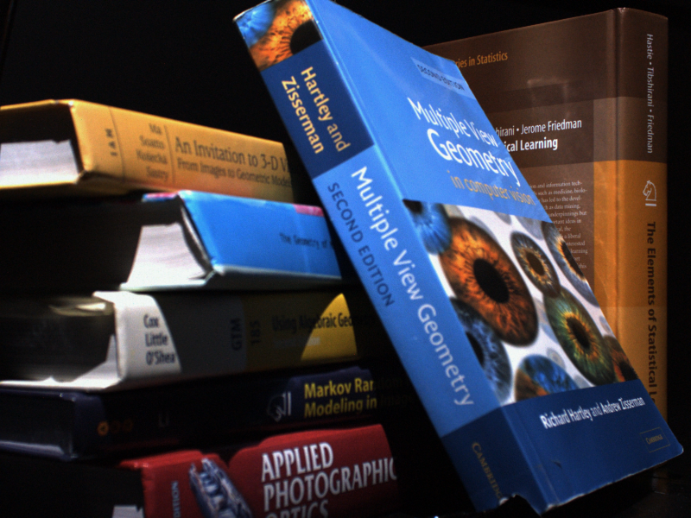
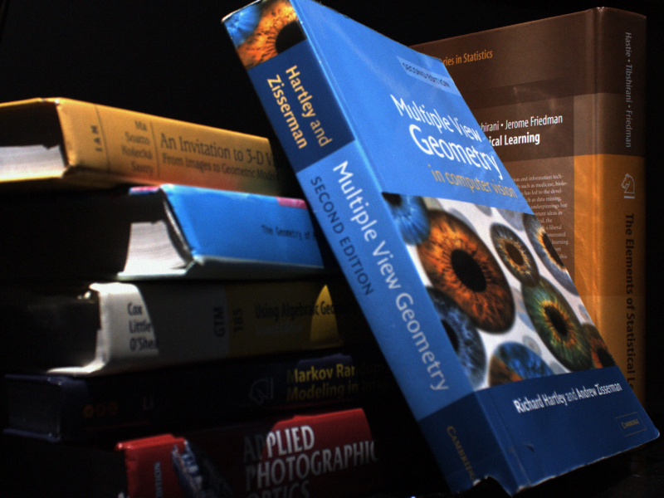
Result
Query
Retrieved

Slide 53
Maxima Matching - II
Query filtered using Gaussian filter of size 12x12, sigma=2, Database image not filtered
Connected Components removed by taking mean
Database Images – 300 (50 from each scene)
Query Images – 18 ( 3 from each scene)
Time Taken to Run – 4 hours
Success Rate (Counting image from same scene as positive match) – 55.5%
Success Rate (Counting image from same pose and differing in illumination level by +/- 3) – 14.2%

Slide 54
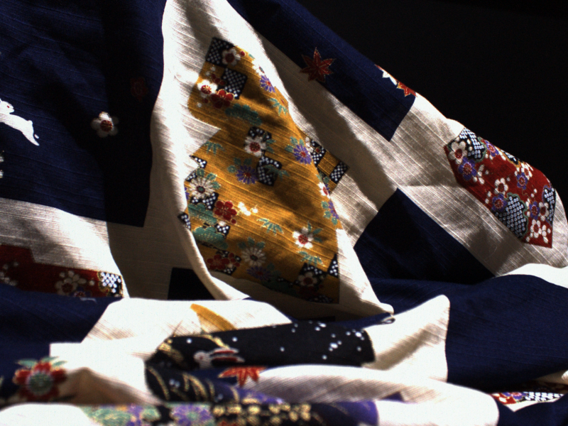

Result
Query
Retrieved

Slide 55
Minima Matching - II
Query & Database image filtered using Gaussian filter of size 15x15, sigma=2
Connected Components removed by taking mean
Database Images – 300 (50 from each scene)
Query Images – 18 ( 3 from each scene)
Time Taken to Run – 4 hours
Success Rate (Counting image from same scene as positive match) –100%
Success Rate (Counting image from same pose and differing in illumination level by +/- 3) –38.4%

Slide 56


Result
Query
Retrieved

Slide 57
Maxima Matching - III
Query & Database image filtered using Gaussian filter of size 15x15, sigma=2
Connected Components removed by taking mean
Database Images – 300 (50 from each scene)
Query Images – 18 ( 3 from each scene)
Time Taken to Run – 4 hours
Success Rate (Counting image from same scene as positive match) –100%
Success Rate (Counting image from same pose and differing in illumination level by +/- 3) –38.4%

Slide 58

Result
Query
Retrieved

Slide 59
Saddle Point Matching
Saddle Points are taken at intersection of watershed and watercourse lines
Query & Database image filtered using Gaussian filter of size 15x15, sigma=2
Connected Components removed by taking mean
Database Images – 300 (50 from each scene)
Query Images – 18 ( 3 from each scene)
Time Taken to Run – 45 hours
Success Rate (Counting image from same scene as positive match) –100%
Success Rate (Counting image from same pose and differing in illumination level by +/- 3) –38.4%

Slide 60


Result
Query
Retrieved

